Slide 1

Hands-On: Web App Development C# and ASP.NET Core 3.0
Scott Dockendorf
Chief Technology Officer, Remote Operations
OCTOBER 10, 2019
Dallas net user group

Slide 2

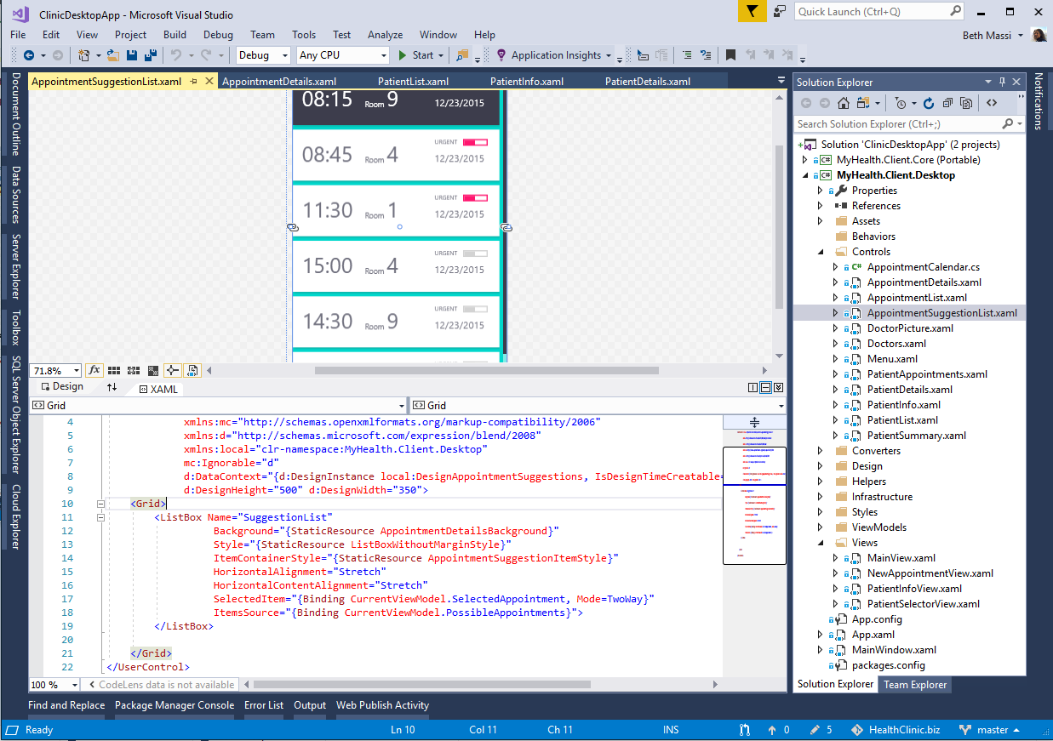
ANNOUNCING
.NET Core 3.0
Windows desktop support with WPF and WinForms, also open source
Flexible deployment, side-by-side support and self-contained EXEs
New C# language features for productivity and less errors
IoT (https://github.com/dotnet/iot) & AI via ML.NET (https://bit.ly/2HOvxSU)
Performance improvements
Full-stack web development with C# and Razor

Slide 3



.NET Core 3.0: A full stack solution
Client
Frontend
Backend
http://..
ASP.NET Core
Worker
API
Blazor
Components
SPA (JavaScript)
MVC / Razor Pages
Web APIs
SignalR
Security & identity
Worker Services
gRPC API

Slide 4
Blazor

Slide 5

Blazor
Build client-side web UI with .NET instead of JavaScript
Call into JavaScript libraries & browser APIs as needed
Write reusable web UI components with C# and Razor
Share .NET code with both the client and the server
Blazor for WebAssembly now in official preview!

Slide 6



Blazor on client or server
Client-side
Server-side
https://...
https...
ASP.NET Core
Razor Components
DOM
SignalR
DOM
.NET
WebAssembly
Razor Components
.NET
Will ship in a future release
Included in .NET Core 3.0

Slide 7
Blazor Approach Comparison
 | Client-Side | Server-side
Pros | Can run offline Faster execution (within browser) Debugging? https://bit.ly/2OMUiz0 | Startup timing is faster. Supports full debugging Supports every .NET API and library which runs with ASP.NET Core. Works also with old browsers that don’t support WebAssembly, like Internet Explorer
Cons | Longer startup timings (load .NET Framework & Assemblies) | Does NOT run offline Slower execution due to required constant connection with the server

Slide 8

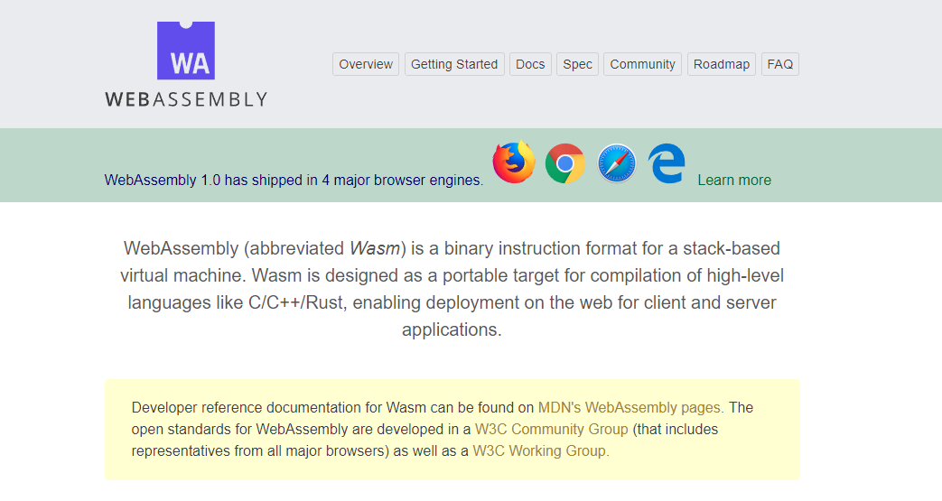
WebAssembly.org
Documentation: https://webassembly.org/docs/high-level-goals/

Slide 9






WebAssembly Working Group https://bit.ly/32yDOCP
Members from industry leaders:

Slide 10
WebAssembly Compatibility
Source: https://caniuse.com/#search=wasm

Slide 11

How WebAssembly Works
.NET Standard 2.0 Build
Delivered to browser
WASM alongside JS/HTML/CSS
MyBlazorClient.dll
MyBlazorClient.dll
JS
mono.wasm + Supporting files
mono.wasm + Supporting files
Referenced Assemblies
Referenced Assemblies
Referenced Assemblies
Referenced Assemblies
HTML
CSS
Referenced Assemblies
Referenced Assemblies

Slide 12
Worker Services

Slide 13
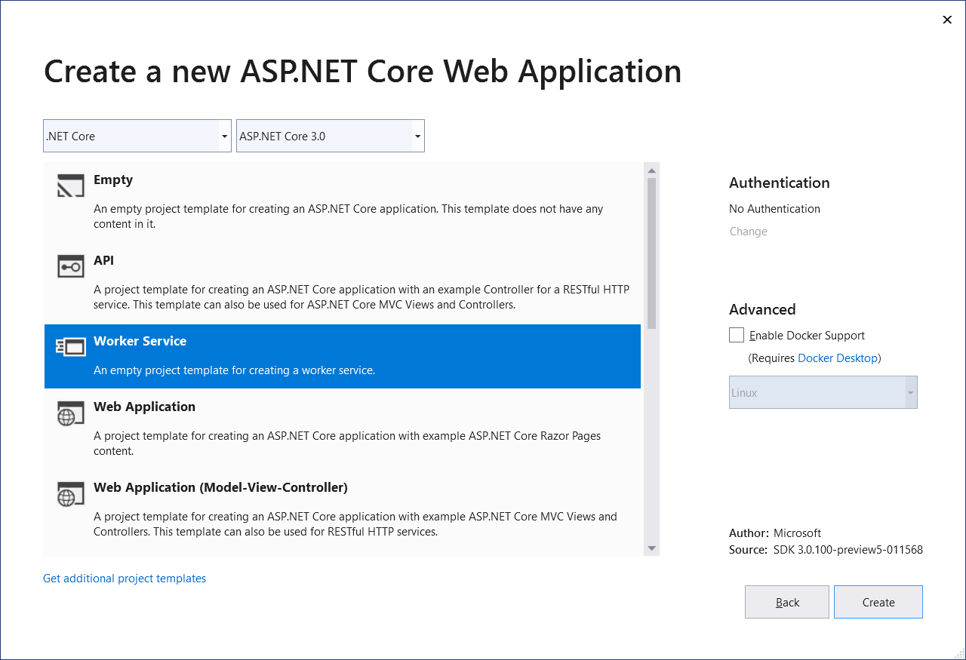
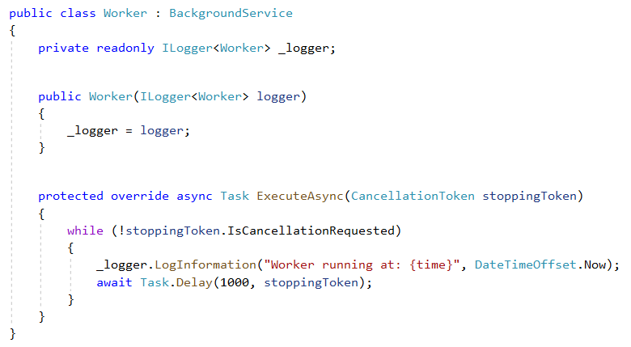
Worker services
.net Core 3.0 provides a new Worker Service template to build long-running worker processes
Integrates with .net core services such as configuration, logging, dependency injection
Host as Windows service, Linux systemd, Azure WebJobs, Docker containers

Slide 14
gRPC

Slide 15




Web API Design Styles
A stateless architecture for data transfer that is dependent on hypermedia.
REST can tie together a wide range of resources that might be requested in a variety of formats for different purposes.
REST is fundamentally concerned with stateless resource management, so it’s best used in such situations.
Systems requiring rapid iteration and standardized HTTP verbiage will find REST best suited for their purposes.
An approach wherein the user defines the expected data and format of that data.
GraphQL is from Facebook, and that pedigree demonstrates its use case well — situations in which the requester needs the data in a specific format for a specific use.
In those cases, those data formats and the relations between them are vitally important, and no other solution provides the same level of interconnected provision of data.
Data updates to be served automatically, rather than requested.
Finally, Webhooks are best used when the API in question primarily updates clients.
While such APIs can also have other functions, even RESTful ones, the primary use of a Webhook microservice should be to update clients and provide updated, provisioned data upon the creation of the new, updated resource.
A contract-first interface-driven, nimble and lightweight system for requesting data.
gRPC, on the other hand, is best used when a system requires a set amount of data or processing routinely, and in which the requester is either low power or resource-jealous.
Examples: IoT, mobile, microservices
Source: https://nordicapis.com/when-to-use-what-rest-graphql-webhooks-grpc/

Slide 16

What is gRPC
gRPC is
modern open source high performance RPC framework that can run in any environment
efficiently connect services in and across data centers with pluggable support for load balancing, tracing, health checking and authentication
applicable in last mile of distributed computing to connect devices, mobile applications and browsers to backend services
USE CASES
Efficiently connecting polyglot services in microservices style architecture
Connecting mobile devices, browser clients to backend services
Generating efficient client libraries
Source: https://grpc.io/about

Slide 17
gRPC Important Concepts
Interoperability: Client libraries in 10 languages C#, C/C++, Dart, Go, Java, Node.js, PHP, Python, Ruby
Protobuf (aka “Protocol buffers”) as interface design language
Highly efficient on wire and with a simple service definition framework
Bi-directional streaming with http/2 based transport (Kestrel)
Pluggable auth, tracing, load balancing and health checking
Source: https://grpc.io/about

Slide 18
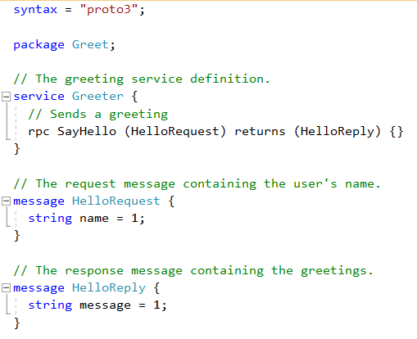
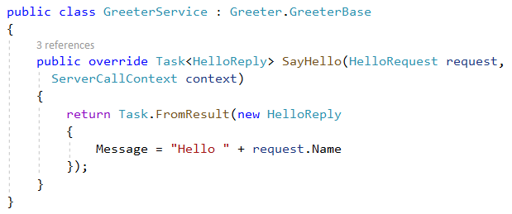
Protobuf ---> C#
gRPC Protobuf
C# Class

Slide 19
Also new in ASP.NET Core 3.0
Blazor (server-side)
gRPC
Worker
Simplified shared framework
IdentityServer
API code generation
Endpoint routing integration
C# 8 in Razor & MVC
JSON
Windows service support
SignalR auto-reconnect, streaming
SignalR C++ client*
Event counters*
Certificate & Kerberos authentication*
Performance
*Coming soon!

Slide 20
References
http://..
Worker
Service
Blazor https://bit.ly/2xJbcIK
Blazor Components https://bit.ly/2LSJrWy
TONS OF BLAZOR RESOURCES https://bit.ly/2K9opyd
Blazor Workshop https://bit.ly/2LUJD7n
gRPC https://grpc.io/
gRPC Quickstart C# https://bit.ly/2LReCkX
When to use gRPC, Webhooks, REST, GraphQL https://bit.ly/2Axjzc0
Worker services https://bit.ly/2XVrZa2
Notes:
Informative links for your review

Slide 21
References
Core Documentation https://aka.ms/dotnet-docs
SDK Documentation https://aka.ms/dotnet-cli-docs
Release Notes https://aka.ms/netcore3releasenotes
Tutorials https://aka.ms/dotnet-tutorials
Introduction https://bit.ly/2XJPH9S
Migrate from ASP.NET to ASP.NET Core https://bit.ly/2ShOKz4
Migrate from 2.2 to 3.0 https://bit.ly/2JU8c1Z
What’s New - https://bit.ly/2JGkIC1
Identity - https://bit.ly/2E9rcqZ
Web APIs - https://bit.ly/2SgaDQc
SignalR - https://bit.ly/2XKK0so

Slide 22
Q&A

Slide 23
Thank you!
Download the slides & demo code @ https://github.com/scottdock
https://Github.com/scottdock
https://twitter.com/scottd
https://www.linkedin.com/in/scottdockendorf

